Slide 1

EXCEL
VLOOKUP & IF STATEMENTS | CTF RESULTS

Slide 2
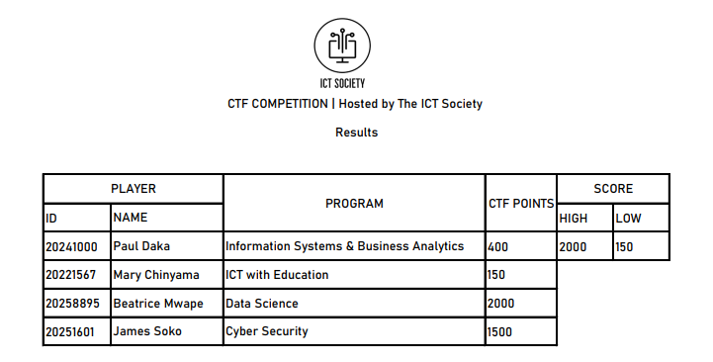
PROJECT | CTF RESULTS

Slide 3

PROJECT | CTF RESULTS (CONTINUES…)

Slide 4
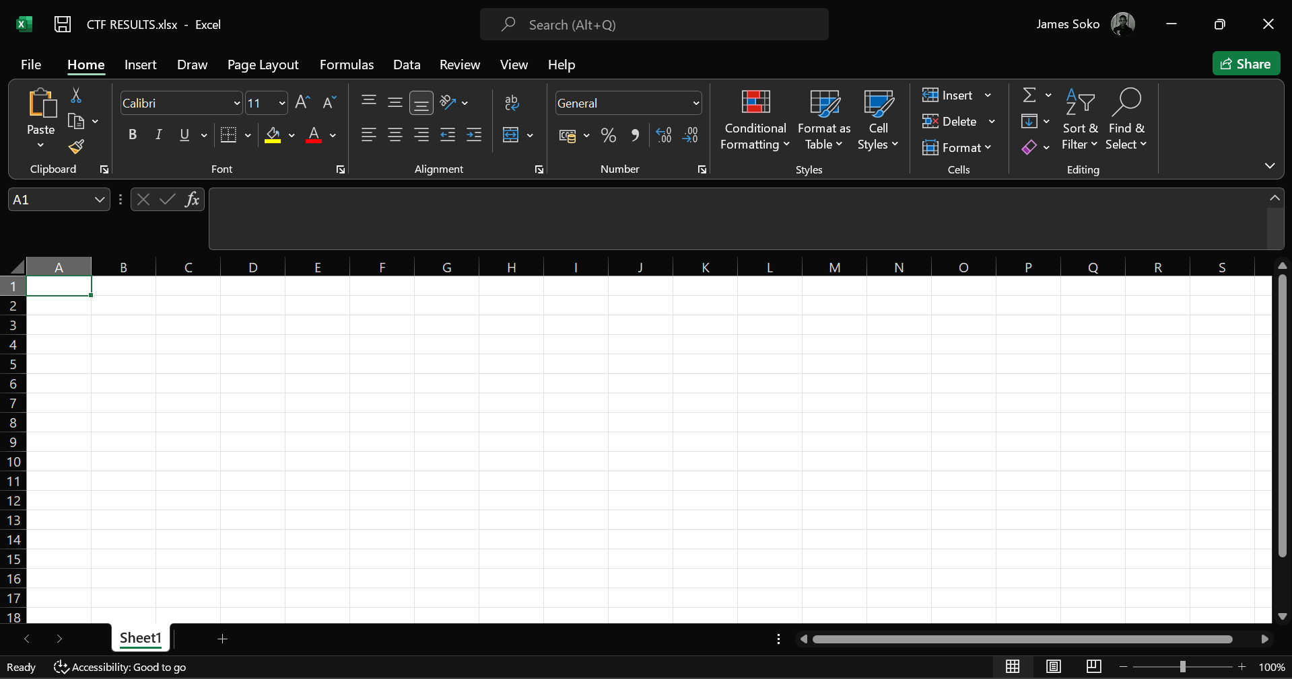
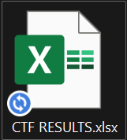
STARTING THE CTF RESULTS PROJECT
Creating an Excel Sheet File
Opening an Excel Sheet File
Go to your preferred Folder, right click → New → New Microsoft Excel Worksheet
Rename the excel file to “CTF RESULTS”
Double click on CTF RESULTS.xlsx

Slide 5
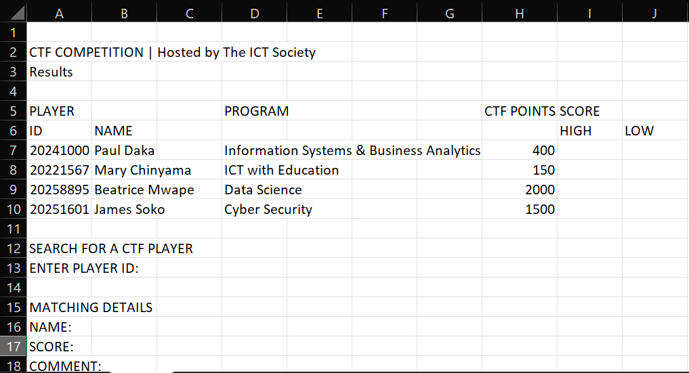
STARTING THE CTF RESULTS PROJECT (continues…)
Enter the following:

Slide 6
PERFECTING THE PROJECT
Merge & Center
Merge & Center (Continues)
Merge & Center A2:J2.
Merge & Center A5:C5.
Merge & Center D5:G6 and Middle Align.
Merge & Center I5:J5.
Merge & Center B7:C7.
Merge & Center B8:C8.
Merge & Center B9:C9.
Merge & Center B10:C10.
Merge & Center B6:C6.
Select B6:B10 and Left Align.
Merge & Center H5:H6 and Middle Align.
Merge & Center A3:J3.
Merge & Center D7:G7.
Merge & Center D8:G8.

Slide 7
PERFECTING THE PROJECT (continues…)
Merge & Center
Merge & Center (Continues…)
Merge & Center D9:G9.
Merge & Center D10:G10.
Select D7:D10 and Left Align.
Merge & Center A12:J12.
Merge & Center A13:B13 and Align Left.
Merge & Center C13:D13.
Merge & Center A15:J15.
Merge & Center B16:C16 and Align Left.
Merge & Center G16:J16 and Align Left.
Merge & Center B18:D18 and Align Left.
Select A7:A10 and Align Left.
Select H7:J10 and Align Left.
Select A5:H10, right click, go to Format Cells… → Border → Outline → Inside → OK

Slide 8
PERFECTING THE PROJECT (continues…)
Border Lines & Pixels
Font & Others
Select I5:J6, right click, go to Format Cells… → Border → Outline → Inside → OK
Drag column 1 to 160 pixels and the rest to 50 pixels.
Select C13, right click, go to Format Cells… → Border → Outline (Choose a thicker line) → OK
Do the above same steps for cell B16, B17, B18 and G16.
Select A2:J18, Middle Align and change font to Bahnscrift.
Merge & Center cell E1:F1 and Insert the ICT Society Logo.
Add the expected things in bold.

Slide 9
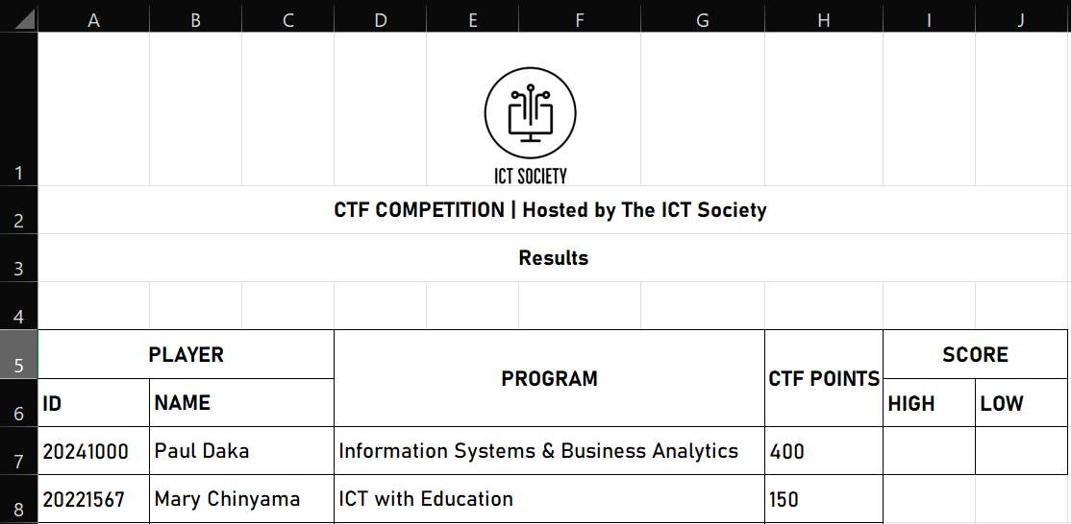
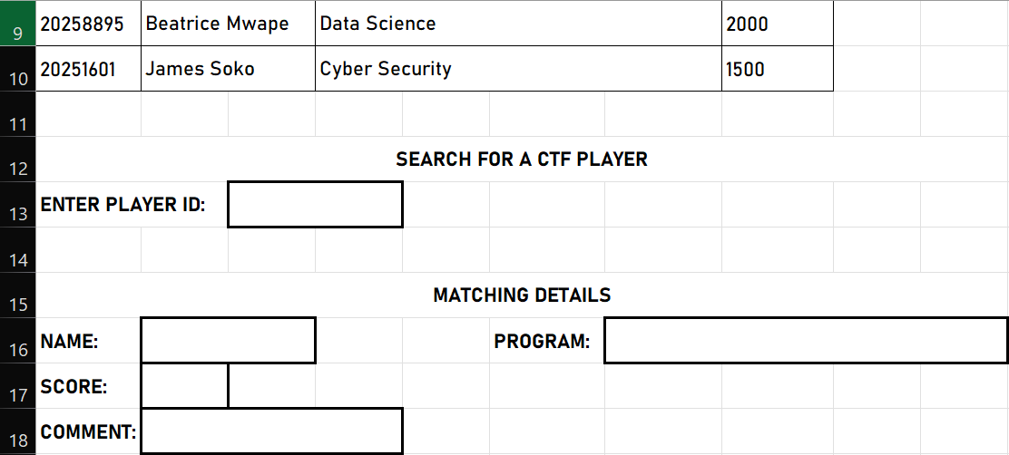
NEW LOOKS OF OUR PROJECT
NOTE:
At this point we can now start looking at:
MAX Function
MIN Function
VLOOKUP Function
IF Function

Slide 10
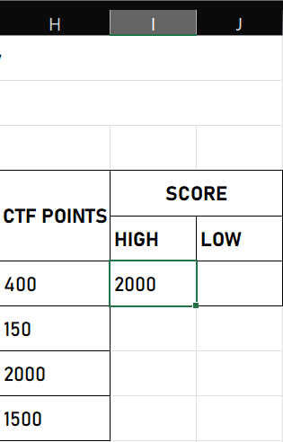
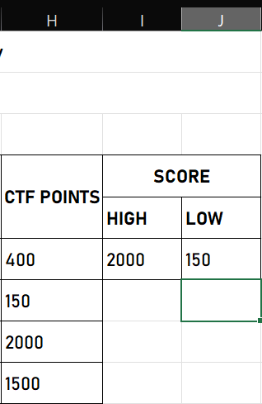
MAX & MIN FUNCTION
MAX Function
MIN Function
In cell I7, insert the formular:
=MAX(H7:H10)
In cell J7, insert the formular:
=MIN(H7:H10)

Slide 11
FUNCTIONS
IFERROR & VLOOKUP Functions
IF, IFERROR & VLOOKUP Functions
In cell B16, insert the formular:
=IFERROR(VLOOKUP(C13, A7:H10, 2, FALSE), VLOOKUP(D13, A7:H10, 2, FALSE))
In cell B17, insert the formular:
=IFERROR(VLOOKUP(C13, A7:H10, 8, FALSE), VLOOKUP(D13, A7:H10, 8, FALSE))
In cell B18, insert the formular:
=IF(B17=I7, "Y0U_4R3_7H3_W1NN3R", IF(B17=J7, "Y0U_H4V3_L0$7"))
In cell G16, insert the formular:
=IFERROR(VLOOKUP(C13, A7:H10, 4, FALSE), VLOOKUP(D13, A7:H10, 4, FALSE))

Slide 12
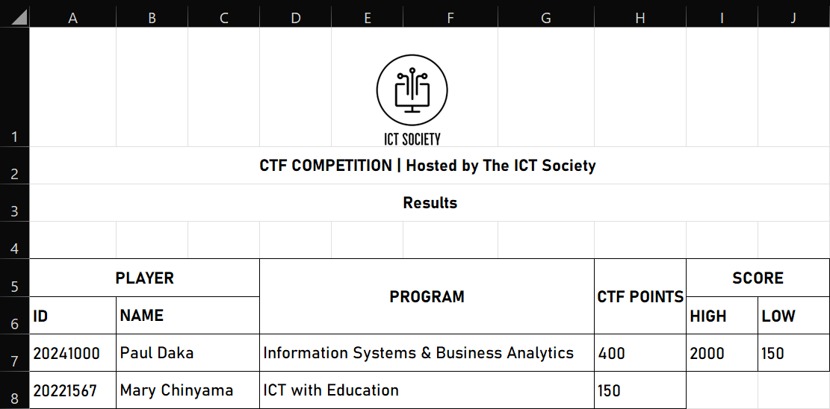
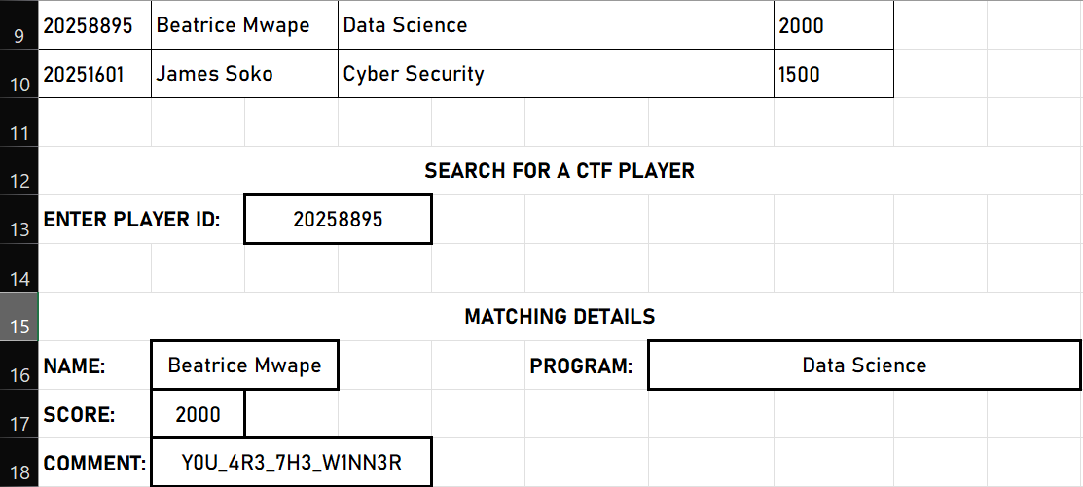
END RESULTS
FINAL PROJECT
Definition Breakdown
At this point, your can search for a player and see their details, that’s the main use of VLOOKUP Functions.
=VLOOPUP(A1,A2:H6,2,FALSE)
VLOOKUP | Function Name
A1 | Cell That Allows To Enter a Value (e.g., ID)
A2:H6 | Cells Containing The Data
2 | Target Column
FALSE | Gives The Exact Value

Slide 13
ICT SOCIETY | EXCEL SLIDES
PREPARED BY JAMES SOKO

